Slide 1
Personal Fitness Lesson #2
Basic Muscle Anatomy and Human Movement

Slide 2
Basic Muscle Anatomy and Joints

Slide 3
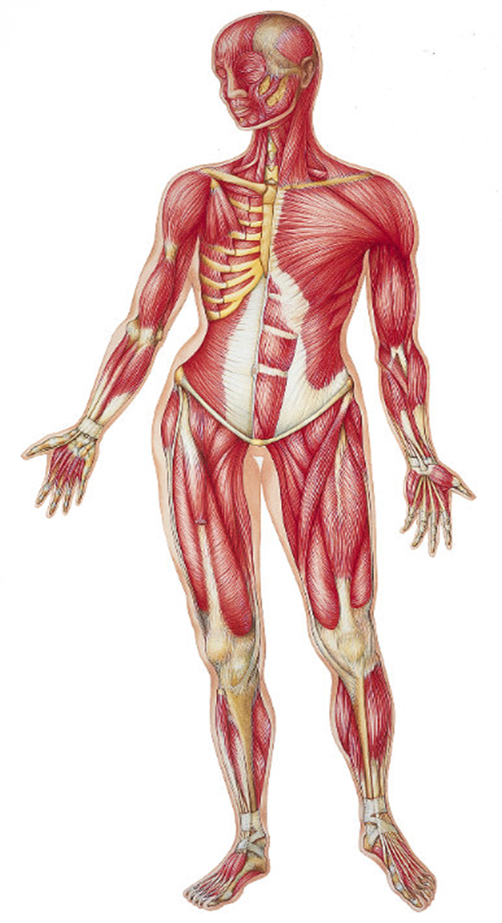
Front View
1. Biceps
2. Pectoralis Major
3. Obliques
4. Abdominals
5. Adductors
6. Quadriceps

Slide 4
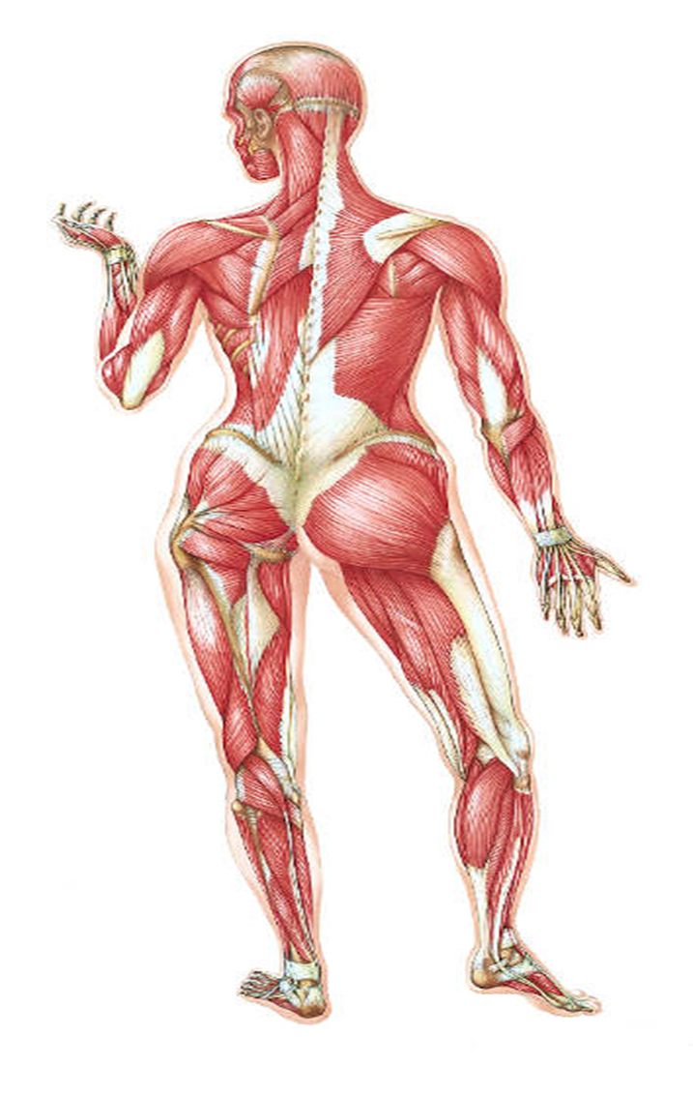
Rear View
1. Gastrocnemius
2. Gluteus Maximus
3. Erector Spinae
4. Trapezius
5. Latissimus Dorsi
6. Triceps
7. Deltoids
8. Hamstrings

Slide 5
Joints
Shoulder
Traps, Lats, Pecs, Delts
Elbow
Biceps, Triceps
Trunk (Core)
Abdominals, Obliques, Erector Spinae
Hip
Gluteus Maximus, Adductors
Knee
Quadriceps, Hamstrings
Ankle
Gastrocnemius

Slide 6
movements that contract the muscles

Slide 7
Flexion- describes a bending movement that decreases the angle between a segment and its proximal segment. For example, bending the elbow, or clenching a hand into a fist, are examples of flexion.
Extension- the opposite of flexion, describing a straightening movement that increases the angle between body parts. For example, when standing up, the knees are extended.

Slide 8
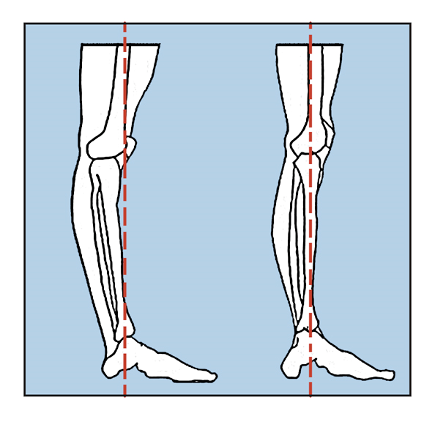
Hyperextension
The prefix hyper is sometimes added to describe movement beyond the normal limits of what the joint is able to do (180˚). For example, if a part of the body such as a joint is overstretched or "bent backwards" because of exaggerated extension motion, then it can be described as hyperextended. Hyperextension increases the stress on the ligaments of a joint, and is not always because of a voluntary movement. It may be a result of accidents, falls, or other causes of trauma. Other times, exercise such as back extensions can be beneficial in terms of strengthening the core and lower back and aid in the prevention of serious injury.

Slide 9
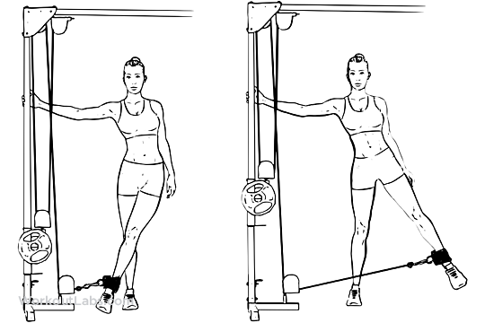
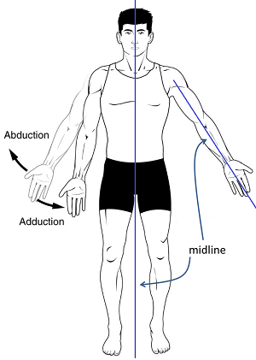
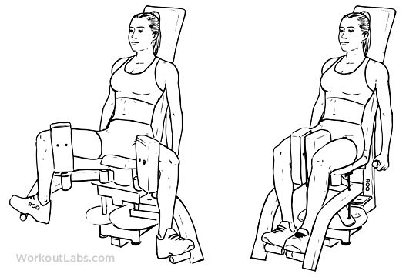
Abduction-refers to a motion that pulls a structure or part away from the midline of the body. In the case of fingers and toes, it refers to spreading the digits apart, away from the centerline of the hand or foot. For example, raising the arms up, such as when tightrope-walking, is an example of abduction at the shoulder.
Adduction- refers to a motion that pulls a structure or part toward the midline of the body, or towards the midline of a limb. In the case of fingers and toes, it refers to bringing the digits together, towards the centerline of the hand or foot. Dropping the arms to the sides, or bringing the knees together, are examples of adduction.

Slide 10
Circumduction- a circular movement of the joint, such as drawing a circle with your wrist that combines abduction, adduction, flexion, and extension.

Slide 11
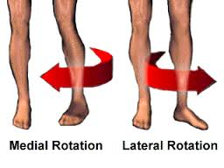
Lateral (external) Rotation- refers to rotation away from (external) the center of the body.
Medial Rotation- refers to rotation inward toward the center of the body.

Slide 12
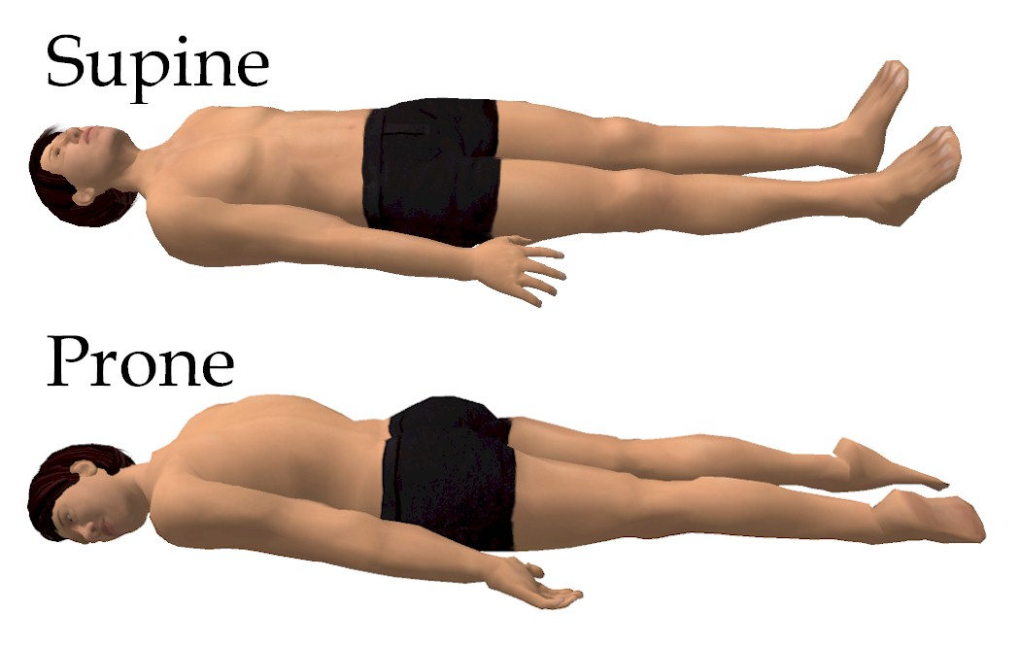
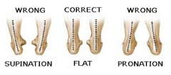
Pronation- inward movement or rotation of the forearm or foot.
Supination- outward movement or rotation of forearm or foot.

Slide 13
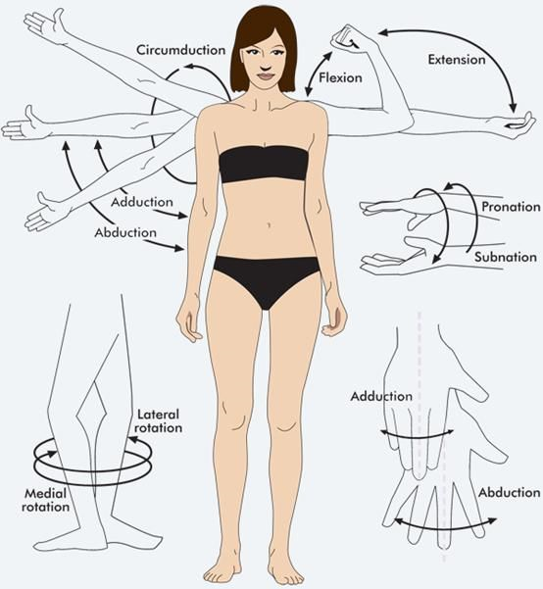

Slide 14
Conclusion
Main muscles and joints
Joint movements that contract the muscles

